Slide 1
Microsoft Cognitive Services
Microsoft Research

Slide 2

Microsoft Cognitive Services
Intelligence APIs for building intelligent apps
Notes:
Cognitive Services includes 21 APIs that fall into five categories: vision, speech, language, knowledge, and search.

Slide 3
Cognitive Services APIs
Vision
Computer Vision
Emotion
Face
Video
Speech
Bing Speech
Custom Recognition
Speaker Recognition
Language
Bing Spell Check
Language Understanding
Linguistic Analysis
Text Analytics
Web Language Model
Knowledge
Academic Knowledge
Entity Linking
Knowledge Exploration
Recom-mendations
Search
Bing Auto-suggest
Bing Image Search
Bing News Search
Bing Video Search
Bing Web Search
Notes:
Microsoft Cognitive Services is a set of intelligent APIs for building equally intelligent applications. It currently offers 21 different API for analyzing images, videos, text, and much more. For more information, visit https://www.microsoft.com/cognitive-services.

Slide 4
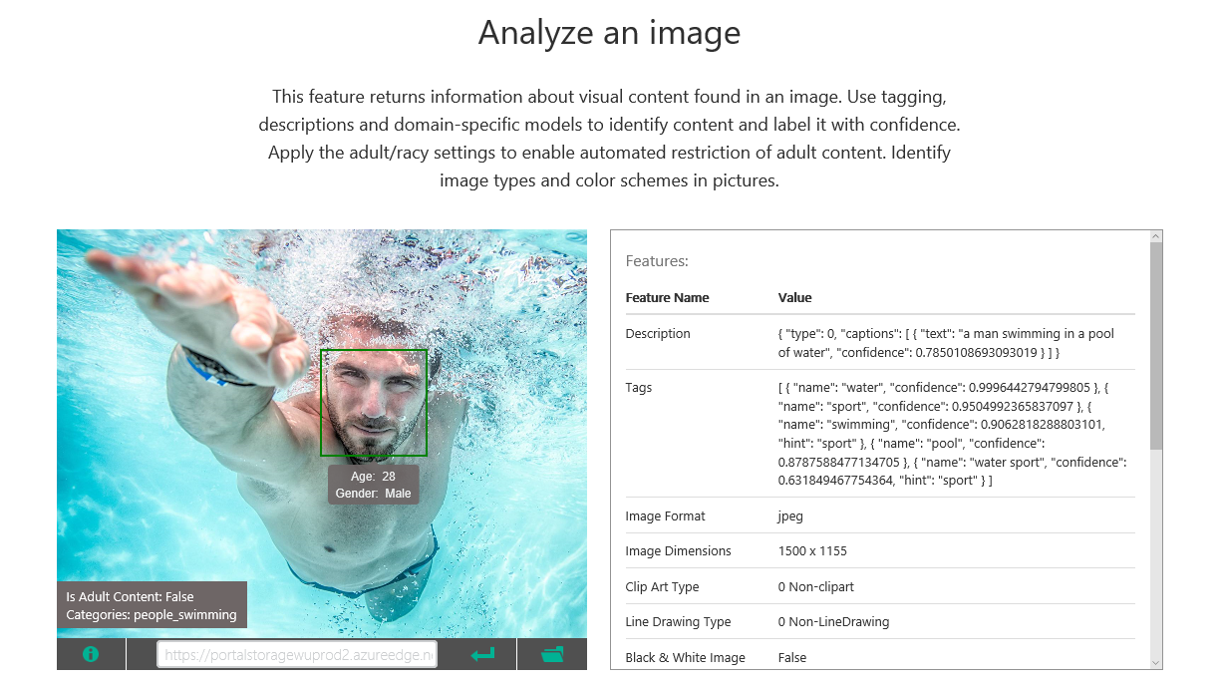
Computer Vision API
Notes:
The Computer Vision API, part of Cognitive Services, offers methods for captioning images, generating metadata keywords, recognizing celebrities, reading text, and generating "smart" thumbnails. For more information, visit https://www.microsoft.com/cognitive-services/en-us/computer-vision-api.

Slide 5
Using the Computer Vision API (C#)
var vision = new VisionServiceClient("subscription_key");
var features = new VisualFeature[] { VisualFeature.Description };
var result = await vision.AnalyzeImageAsync(uri, features);
string caption = result.Description.Captions[0].Text);
foreach (string tag in result.Description.Tags)
{
// tag holds descriptive tag for image (e.g., "river")
}
Notes:
Students will write code similar to this in the next lab to submit images uploaded to a Web site to the Computer Vision API in order to generate captions and search keywords. This example is written in C# for Microsoft .NET. This example uses the Microsoft.ProjectOxford.Vision NuGet package and passes the image via URI, but callers can pass a stream instead. Other VisualFeatures include Adult, Category, Color, Faces, ImageType, and Tags.

Slide 6
Using the Computer Vision API (Node.js)
var options = {
url: "https://api.projectoxford.ai/vision/v1.0/analyze",
qs: { visualFeatures: "Description" },
method: 'POST',
headers: {
'Content-Type': 'application/json',
'Ocp-Apim-Subscription-Key': 'subscription_key'
},
...
};
request(options, function(err, response, result) {
if(!err) {
var caption = result.description.captions[0].text;
}
});
Notes:
Students will write code similar to this in the next lab to submit images uploaded to a Web site to the Computer Vision API in order to generate captions and search keywords. This example is written in JavaScript for Node.js. This example uses Cognitive Services' REST API and passes the image via URI, but callers can pass a stream instead. Other VisualFeatures include Adult, Category, Color, Faces, ImageType, and Tags.

Slide 7
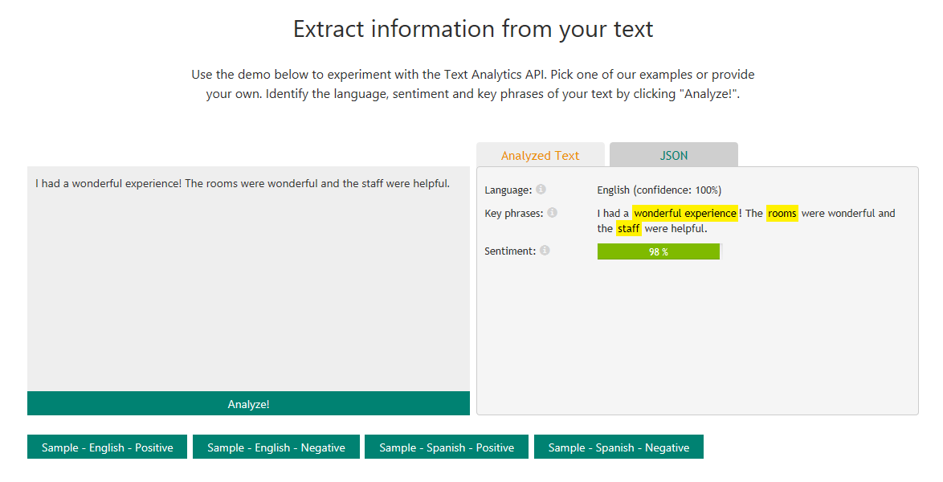
Text Analytics API
Notes:
The Text Analytics API can be used to perform sentiment analysis, extract key phrases, detect topics, and detect language. Here is a more information on each feature:
Sentiment analysis - The API returns a numeric score between 0 and 1. Scores close to 1 indicate positive sentiment and scores close to 0 indicate negative sentiment. Sentiment score is generated using classification techniques. The input features of the classifier include n-grams, features generated from part-of-speech tags, and word embeddings. English, French, Spanish and Portuguese text are supported.
Key phrase extraction - The API returns a list of strings denoting the key talking points in the input text. We employ techniques from Microsoft Office's sophisticated Natural Language Processing toolkit. English, German, Spanish, and Japanese text are supported.
Topic detection - This is a newly released API that returns the detected topics for a list of submitted text records. A topic is identified with a key phrase, which can be one or more related words. This API requires a minimum of 100 text records to be submitted, but is designed to detect topics across hundreds to thousands of records. Note that this API charges 1 transaction per text record submitted. The API is designed to work well for short, human-written text such as reviews and user feedback.
Language detection - The API returns the detected language and a numeric score between 0 and 1. Scores close to 1 indicate 100% certainty that the identified language is true. A total of 120 languages are supported.
For more information, see https://www.microsoft.com/cognitive-services/en-us/text-analytics-api.

Slide 8
Using the Text Analytics API (JavaScript)
var input = "{'documents':[{'language':'en','id':'1000','text':" + twitterText + "}]}";
$.ajax({
url:"https://westus.api.cognitive.microsoft.com/text/analytics/v2.0/sentiment",
beforeSend: function(xhr){
xhr.setRequestHeader("Content-Type", "application/json");
xhr.setRequestHeader("Ocp-Apim-Subscription-Key", "{key}");
},
type: "POST",
data: input
}).done(function(data) {
alert(data.documents[0].score); // Sentiment from 0.0 to 1.0
}).fail(function() {
alert("error");
});
Notes:
This example uses JavaScript to call the Text Analytics API to analyze some Twitter text for sentiment. It uses jQuery's $.ajax function, so it would work in any browser once jQuery is loaded.

Slide 9
Hands-On Lab
Using Cognitive Services
Microsoft Cognitive Services HOL.html

